Slide 1
Town Hall Special:
Q&A Discussion on the Paycheck Protection Program
April 22, 2020

Slide 2
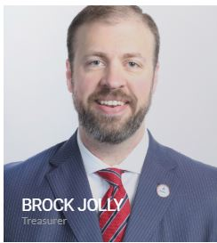
Today’s Host

Slide 3
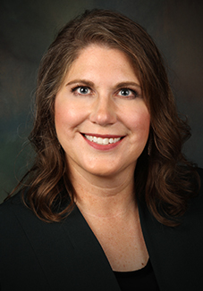
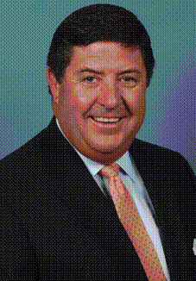


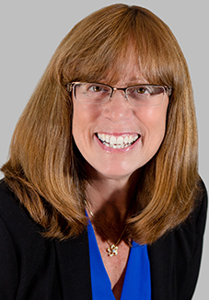
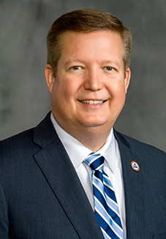
Executive Committee
Cammie Scott
Tom Michel
Lawrence Holzberg
Brock Jolly
Jill Judd
Kevin Mayeux
President
President Elect
Secretary
Treasurer
Past President
CHIEF EXECUTIVE OFFICER

Slide 4
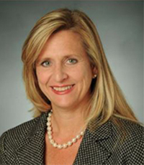
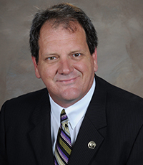


SPEAKERS
Diane Boyle
Keith M. Gillies
Todd Villarrubia
Mark Massey
SVP Government Relations, NAIFA
Managing Principal of Wealth Solutions, LLC
Board Certified Expert in Estate Planning and Administration
Vice President of SMA Services Inc

Slide 5
Background
3 Relief Bills
Guidance by Treasury and DOL
Loan Provisions included:
  EIDL
  PPP
On-Demand Recording Found under Events/Town Hall on belong.naifa.org

Slide 6
Town Hall on April 16th
Payment Protection Plan Deep Dive
  Judi Carsrud
  Kate Jensen & Scott Sinde of Steptoe & Johnson

Slide 7
Let’s Get Into the Discussion
Your Questions

Slide 8
Loans
EIDL, PPP and More

Slide 9
Payroll Tax Deferral
Eligibility, Timing & Access

Slide 10
Tax Rebate
Eligibility, Qualifications & Limits

Slide 11
Unemployment Insurance Benefits
Eligibility and Use Cases

Slide 12
Retirement Savings Plan Relief Provisions
What Are Clients Asking?

Slide 13
Required Minimum Distributions (RMD)
What are the Effects of COVID-19?

Slide 14
Paid Sick and Family Leave Requirements
What You Need to Know

