Slide 1
Town Hall
April 6, 2020

Slide 2
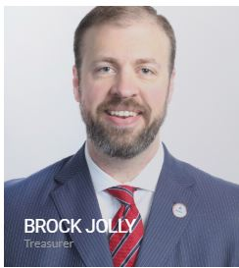
Today’s Host

Slide 3
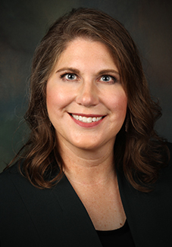
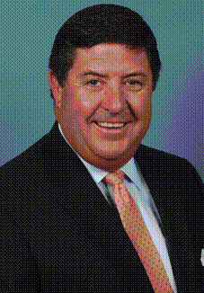

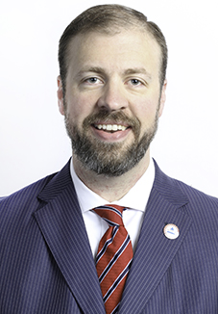
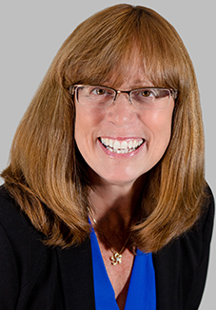
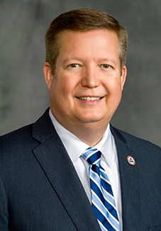
Executive Committee
Cammie Scott
Tom Michel
Lawrence Holzberg
Brock Jolly
Jill Judd
Kevin Mayeux
President
President Elect
Secretary
Treasurer
Past President
CHIEF EXECUTIVE OFFICER

Slide 4
Today’s Agenda:
Brock’s Thoughts
CEO Update
Jamie Hopkins

Slide 5
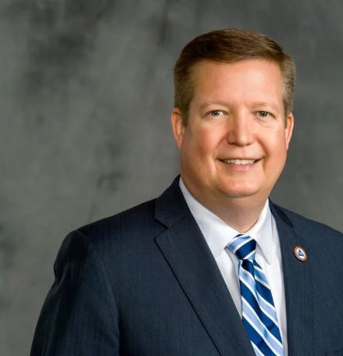
CEO Update
Kevin Mayeux, CAE
NAIFA CEO

Slide 6
CEO Update
Letter on Easing Licensing Requirements & Commissions
Special Week of Events at NAIFA:
  Wednesday, April 8th:
  Members-Only Q&A Session on the CARES Act
  Thursday, April 9th:
  NAIFA Live with Bill Cates including a Virtual Book Signing
  Tuesday, April 14th:
  Tom Hegna by Popular Demand

Slide 7
Speaker Introduction

Slide 8

Jamie Hopkins, Esquire, MBA, CFP, LLM, CLU, ChFC, RICP

