Slide 1
Town Hall
March 27, 2020

Slide 2
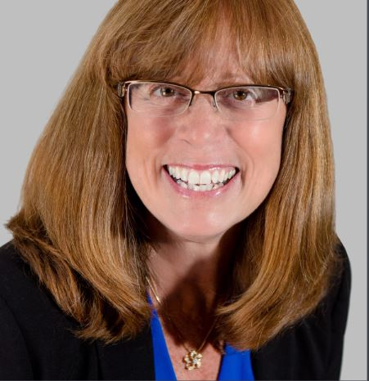
Today’s Host
Jill Judd, LUTCF, FSS
Immediate Past President

Slide 3
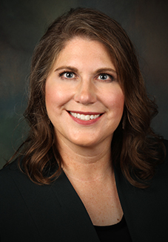
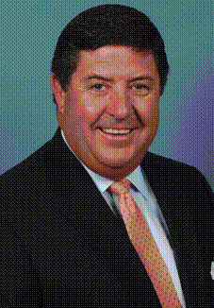
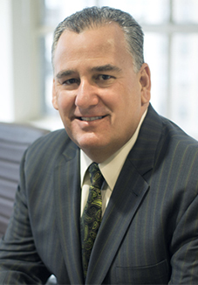
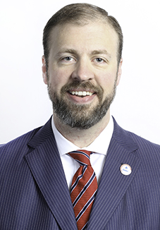
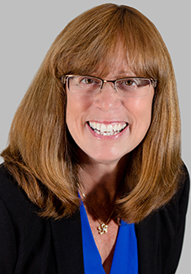
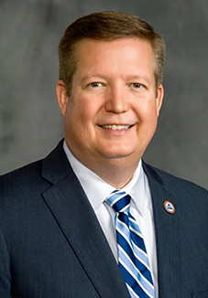
Executive Committee
Cammie Scott
Tom Michel
Lawrence Holzberg
Brock Jolly
Jill Judd
Kevin Mayeux
President
President Elect
Secretary
Treasurer
Past President
CHIEF EXECUTIVE OFFICER

Slide 4
Today’s Agenda:
What a Week! Perspectives from Jill
CEO Update
New Resources & Ways to Get Involved
On-demand versions & registration located at:
members.naifa.org/townhall

Slide 5




Notes:
Talk about the Alliance

Slide 6
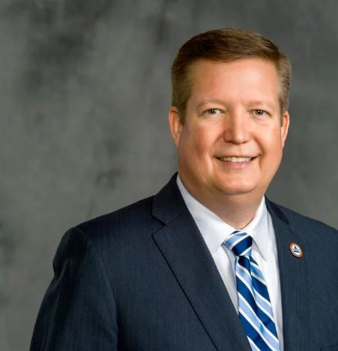
CEO Update
Kevin Mayeux, CAE
NAIFA CEO

Slide 7
CEO Update
NAIFA is on FEMA NBEOC
NAIFA is here for Federal & State Legislators
We are open for business
Recommendations for NAIFA events
NAIFA Live: Virtual for Q2
Congressional Conference Update

Slide 8
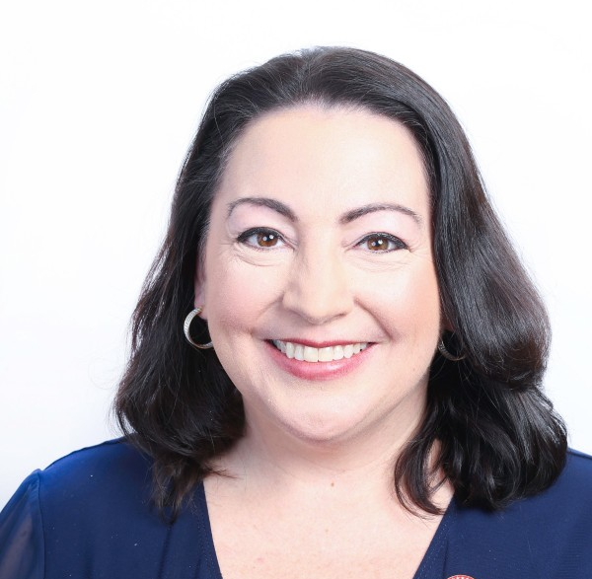
COVID-19 Resouces
Suzanne Carawan, MPH, MBA
NAIFA VP Marketing & Communications

Slide 9
Introduction to Today’s Spotlight Speaker
Jill Judd, LUTCF, FSS
Immediate Past President

Slide 10
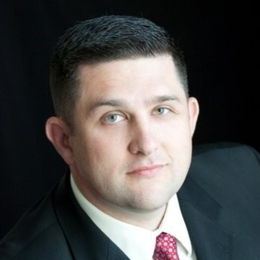
Ryan Pinney, LACP
President
Pinney Insurance Center, Inc.

Slide 11
A Look Ahead
Email in Your Inbox with Recap & Resources from the Week
Next Week: Van Mueller

