Slide 1
Town Hall
March 26, 2020

Slide 2
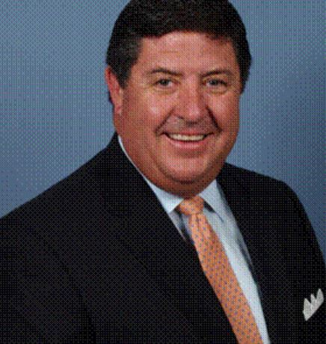
Today’s Host
Tom Michel, LACP
NAIFA President-Elect

Slide 3
Today’s Agenda:
Thoughts from Tom
CEO Update
New Resources & Ways to Get Involved
On-demand versions & registration located at:
members.naifa.org/townhall

Slide 4
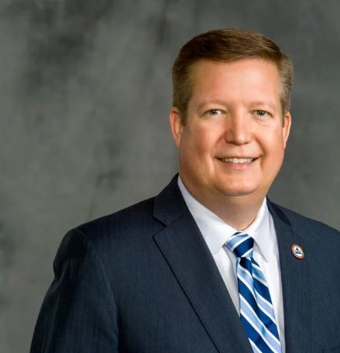
CEO Update
Kevin Mayeux, CAE
NAIFA CEO

Slide 5
CEO Update
NAIFA is on FEMA NBEOC
NAIFA is here for Federal & State Legislators ** Press Release today
We are open for business
Recommendations for NAIFA events
NAIFA Live: Virtual for Q2
Congressional Conference

Slide 6
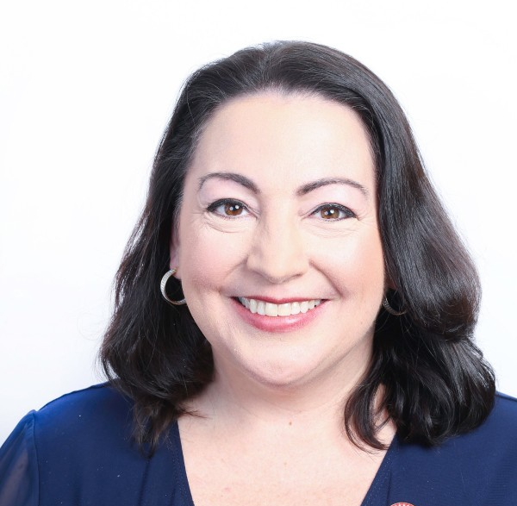
COVID-19 Resouces
Suzanne Carawan, MPH, MBA
NAIFA VP Marketing & Communications

Slide 7
Introduction to Today’s Spotlight Speakers
Tom Michel, LACP
President-Elect

Slide 8
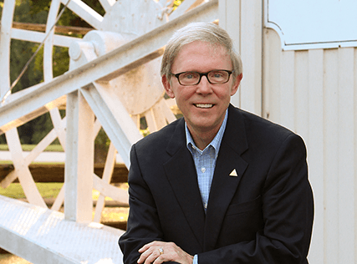
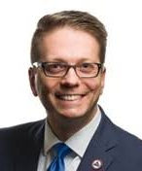
John D. Richardson,
RICP, LACP
Ike S. Trotter,
CLU RICP ChFC

