Slide 1
Town Hall
March 25, 2020

Slide 2
Reminders:
On-demand versions & registration located at:
members.naifa.org/townhall

Slide 3
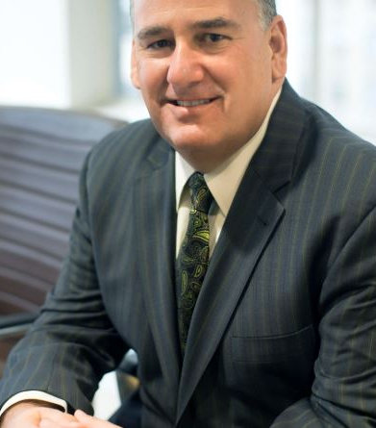
Today’s Host
Larry Holzberg, LUTCF, LACP
NAIFA Secretary

Slide 4
Agenda
Executive Committee Host: Larry Holzberg
CEO Update: Kevin Mayeux
COVID-19 Resources: Suzanne Carawan
Business Performance Spotlights: Tom Hegna
Notes:
CEO Update
Chapter Services Team Staffing Changes
COVID-19
NEW: Financial Security Alliance
Marketing & Communications Update
Reminders/Announcements

Slide 5
Town Hall Schedule this Week
Thursday, March 26th @ 12 noon eastern
Ike Trotter, CLU, RICP, ChFC
Adapting to New Technologies
Friday, March 27th @ 12 noon eastern
Ryan Pinney, LACP
Running Your Agency Virtually

Slide 6
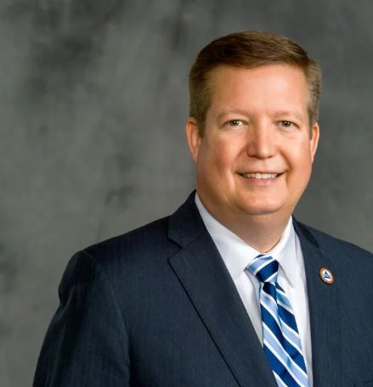
CEO Update
Kevin Mayeux, CAE
NAIFA CEO

Slide 7
CEO Update
NAIFA is on FEMA NBEOC
NAIFA is here for Federal & State Legislators
Teleworking Policy & Debriefs for NAIFA Leaders & Chapters
Recommendations for NAIFA events
NAIFA Live: Virtual for Q2
Congressional Conference
** Letter to CEOs on Commission for Producers

Slide 8
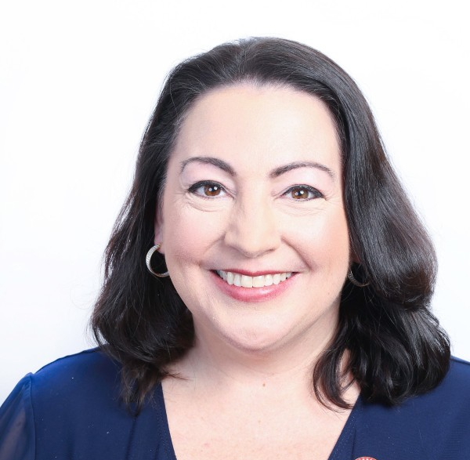
COVID-19 Resouces
Suzanne Carawan, MPH, MBA
NAIFA VP Marketing & Communications

Slide 9
Introduction to Today’s Spotlight Speaker
Larry Holzberg, LUTCF, LACP
NAIFA Secretary

Slide 10
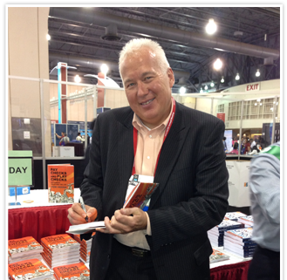
Tom Hegna
CLU ChFC CASL LACP
LOYAL MEMBER SINCE 1989
www.tomhegna.com

