Slide 1
Town Hall
March 24, 2020

Slide 2
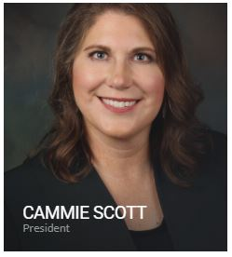
President Update
Cammie Scott, LUTCF REBC RHU
NAIFA President

Slide 3
Agenda
President’s Address: Cammie Scott
Executive Committee Host: Brock Jolly
CEO Update: Kevin Mayeux
COVID-19 Resources: Suzanne Carawan
Business Performance Spotlights: Jill Judd
Notes:
CEO Update
Chapter Services Team Staffing Changes
COVID-19
NEW: Financial Security Alliance
Marketing & Communications Update
Reminders/Announcements

Slide 4
We’re Here for You
What do you need?
What are you hearing?

Slide 5
Town Hall Schedule this Week
Wednesday, March 25th @ 12 noon eastern
Tom Hegna,CLU,ChFC, CASL, LACP
Opportunities Abound in Crisis
Thursday, March 26th @ 12 noon eastern
Ike Trotter, CLU, RICP, ChFC
Adapting to New Technologies
Friday, March 27th @ 12 noon eastern
Ryan Pinney, LACP
Running Your Agency Virtually

Slide 6
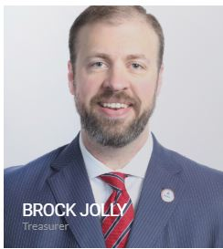
Executive Committee: Brock Jolly, Treasurer

Slide 7

NAIFA Update
Great Webinar Yesterday (Listen on Demand)
Thanks for Positive Feedback
My Advice:
  Be Proactive, Be a Leader, Be Empathetic & Be Honest
  Client Communication is Essential—Reviews, Calls, Texts, E-mails
  Every Day is a Great Day to Get Better—To Do Lists, Professional Designations, etc.
Goal of Today
Please Continue to Communicate With Us!

Slide 8
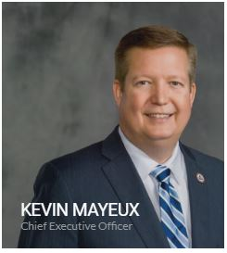
CEO Update
Kevin Mayeux, CAE
NAIFA CEO

Slide 9
CEO Update
NAIFA is on FEMA NBEOC
NAIFA is here for Federal & State Legislators
Teleworking Policy & Debriefs for NAIFA Leaders & Chapters
Recommendations for NAIFA events
NAIFA Live: Virtual for Q2
Congressional Conference
** Letter to CEOs on Commission for Producers

Slide 10
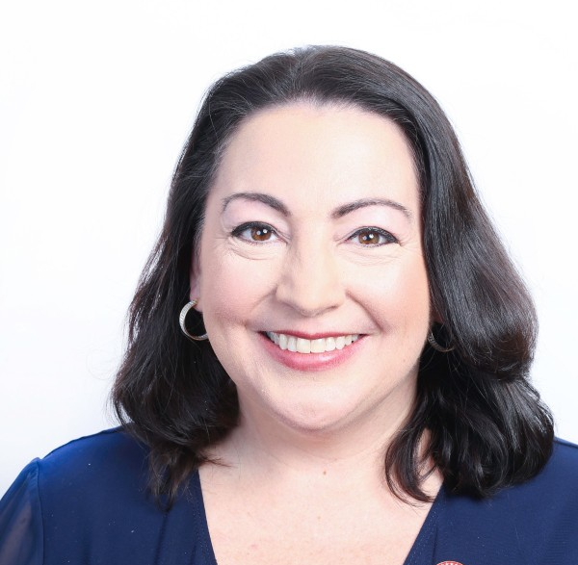
COVID-19 Resouces
Suzanne Carawan, MPH, MBA
NAIFA VP Marketing & Communications

Slide 11
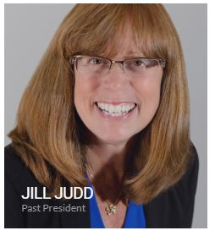
Business Performance Center Spotlight
Jill Judd
State Farm
NAIFA Immediate Past President

Slide 12
Closing Comments
Tomorrow’s
Session:
Tom Hegna

