Slide 1
Town Hall Special:
Q&A Discussion on the Paycheck Protection Program
April 22, 2020

Slide 2
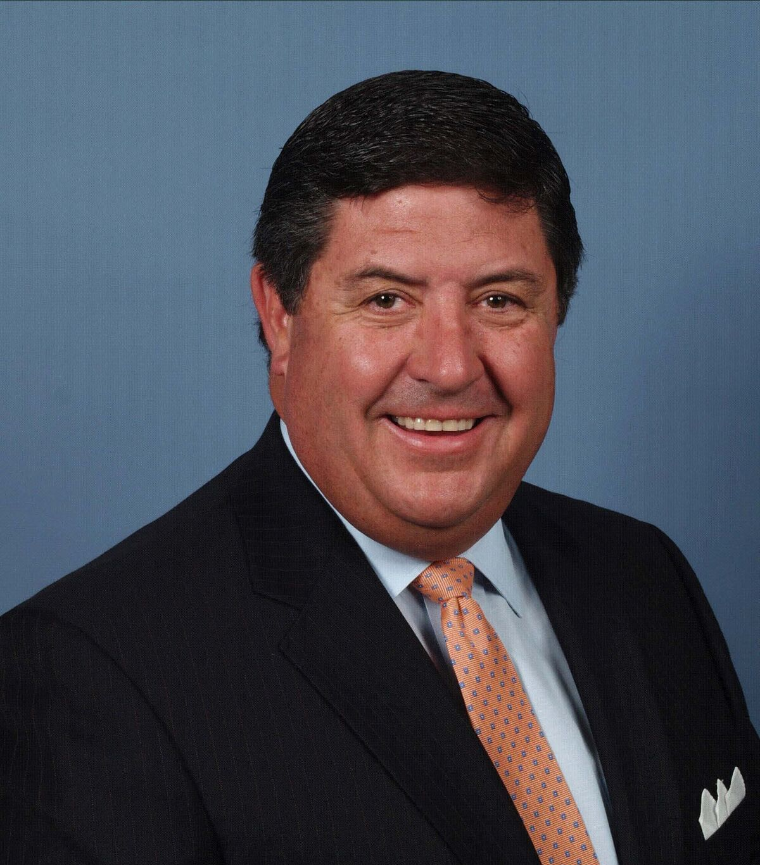
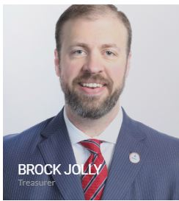
Today’s Host
Tom Michel
NAIFA President-Elect

Slide 3
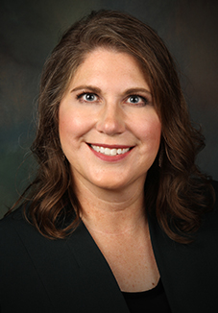
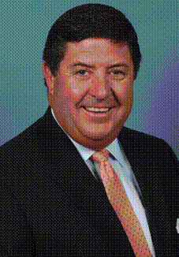

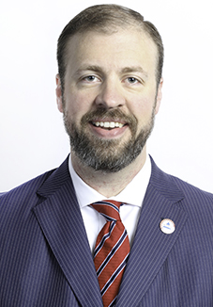
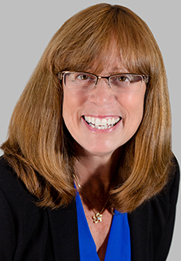
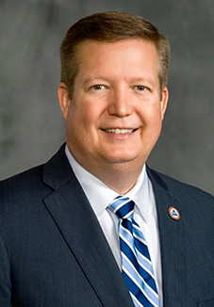
Executive Committee
Cammie Scott
Tom Michel
Lawrence Holzberg
Brock Jolly
Jill Judd
Kevin Mayeux
President
President Elect
Secretary
Treasurer
Past President
CHIEF EXECUTIVE OFFICER

Slide 4
Today’s Agenda
Welcome: Tom Michel, NAIFA President-Elect
CEO Update, Kevin Mayeux
Guest Speakers: Scott Sinder & Kate Jensen

Slide 5
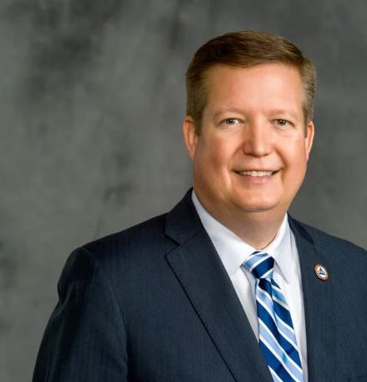
CEO Update
Kevin Mayeux, CAE
NAIFA CEO

Slide 6
CEO Updates
NAIFA Family Response Fund
  Donate www.cfacadiana.org/NAIFA
  NAIFA members can receive grants

Slide 7
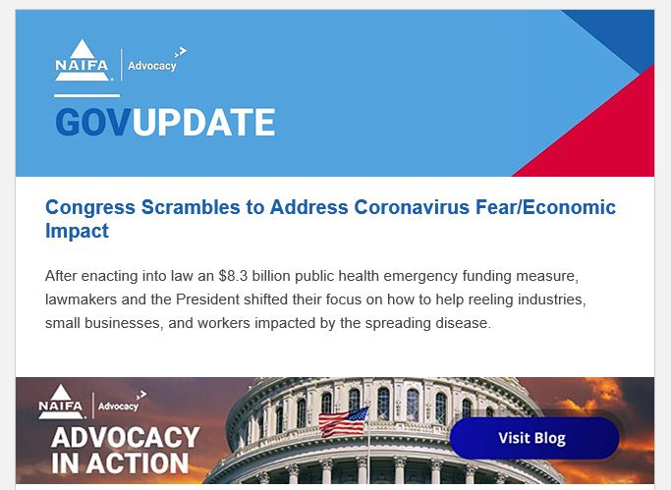
NAIFA GR Team at Work
House is voting today
Expect a GovUpdate tomorrow
New! Real time tracking of state
legislation, sessions & data
https://advocacy.naifa.org/covid-19

Slide 8

Special Webinar Invitation
How to Engage with Congress During the Coronavirus Outbreak
May 5th | 12 noon EDT

Slide 9


Slide 10
Guest Speaker Introduction

Slide 11

Guest Speakers

Slide 12

IRS to Host Webinar for Main Street Businesses and Workers
Internal Revenue Service Commissioner Chuck Rettig, Chief of IRS Communications Terry Lemons, and Customer Service Strategy Project Manager James Clifford
Thursday, April 23rd at 2:00PM ET
A chance for the public to ask questions directly to the IRS about how relief payments from the CARES Act work, as well as a number of other topics regarding COVID-19.
Registration link provided in Zoom chat.

