Slide 1

ADAPTING YOUR PRACTICE TO THE NEW BUSINESS REALITY:
Becoming Blockbuster or New Netflix?
Presented by Tom Guzzardo and Henry Whitlow
TOM GUZZARDO HENRY WHITLOW
Phone: 678.898.5885 404.202.6464
Email: tom@topleaderscoach.com hwhitlow@cau.edu

Slide 2
The New Business Reality
Trends Create Opportunities to Serve People Differently
Are You Truly Effective NOW?
Blockbuster or the New Netflix?
Notes:
Technological advances provide an ongoing source of new business ideas.
In most cases, the technology itself isn’t the key to recognizing business opportunities. Instead, the key is to recognize how technologies can be used and harnessed to help satisfy basic or changing human needs.
For example, the creation of the cell phone is a technological achievement, but it was motivated by an increasingly mobile population that finds many advantages to having the ability to communicate with co-workers, customers, friends and families from anywhere and everywhere.
Technological advancements also provide opportunities to help people perform everyday tasks in a better or more convenient way.

Slide 3
The New Business Reality
Trends Create Opportunities to Serve People Differently
Adapting Your Business & Systems To Deliver
An Extraordinary Client Experience
In the New Business Reality
Notes:
Technological advances provide an ongoing source of new business ideas.
In most cases, the technology itself isn’t the key to recognizing business opportunities. Instead, the key is to recognize how technologies can be used and harnessed to help satisfy basic or changing human needs.
For example, the creation of the cell phone is a technological achievement, but it was motivated by an increasingly mobile population that finds many advantages to having the ability to communicate with co-workers, customers, friends and families from anywhere and everywhere.
Technological advancements also provide opportunities to help people perform everyday tasks in a better or more convenient way.

Slide 4
Components of Your Business Systems
People
Technology
Processes

Slide 5
EXTRAORDINARY CLIENT EXPERIENCE
Understand Your Clients’ Changing Need(s)
Give The Client a Plan / Program They Believe . . .
      . . . Will Meet their REAL Need(s)
      . . . Coming From Service not Sales
Have Business Systems to Effectively Deliver

Slide 6

ADAPTING TO THE NEW BUSINESS REALITY
Are you Harnessing the POWER of Virtual Teams, Virtual Marketing Events that truly serve your people?
Understand 4 Key Trends
Build Virtual Teams
Adapt Your Systems
Build Virtual Marketing
Business Action Plan

Slide 7

Key Trends Creating the New Business Reality
“What Customers Now Need vs What I Sell”
1. Forecasting Customer Outcomes (Close Gaps)
4. Effective Marketing on Screens
Extraordinary Client Experience
2. Effective Virtual Teams
“Get on Their Screens!”
“Who Do We Need to Get the Job Done Well?”
3. Effective Communications Technology
“Lets Get Together Virtually and Do Real Work”

Slide 8

Practical Applications of Forecasting Customer Outcomes
“What Customers REALLY NEED vs What I WANT to Sell”
Forecasting Customer Outcomes
  Study and KNOW your Client’s World (Pain and Problems)
  Your Industry Trends (Reg BI)
  Economic Trends Impacting Clients : New Products
  Adjust your products, adjust your team to respond

Slide 9
Practical Applications of Virtual Teams
“WHO Do We Need to Get the Job Done Well?”
Effective Virtual Teams
  “Professional Advisor Power Teams” TM*
  “Core Support Virtual Teams” TM*
  “Client Advisor Team” TM*
  Communications Technical Support

Slide 10
Practical Applications : Your “Professional Advisor Power Team”TM
“WHO Do We Need to Get the Job Done Well?”
  Building your “Professional Advisor Power Team” TM
    Who to include to work with clients
    How to recruit and add value
    Having ongoing meetings – Creating Action Plans
  Six Possibilities for Membership
  Legal Advisors
  Real Estate Advisors
  Insurance / Risk Management
  Mortgage Brokers
  Accounting and Tax Advisors
  Other Professional with Similar Clients (Commercial, Bookkeeper, etc.)

Slide 11
Practical Applications : Your “Client Advisor Team”
“Who Do We Need to Get the Job Done Well?”
  Building Your “Client Advisor Team” TM
    Who To Invite
    How To Recruit
    Having Ongoing Meetings W/Agendas
Action Steps To Build Your “Client Advisor Team” TM
  List Your Top 7 Satisfied Clients
  History Of Extraordinary Experience With You
  Given You Referrals
  Invite Them To Your Inner Circle
  Ongoing Conversations For Improving Your Client Experience

Slide 12
Practical Applications of Communications Technology
“Lets Get Together Virtually and Do Real Work”
Utilizing Communications Technology:
HOW We Now Work Together
  Zoom Client Meetings
    Set up client meeting, provide delivered Lunch, create clarity about needs and financial game plan, ask for referrals
  Webinars
  Zoom Group Chat
  Virtual Conference Room

Slide 13
Practical Applications of Virtual Marketing Plans
“Get on Their Screens!”
Build Virtual Marketing Plan/Events
  Client Webinars – Topics Relevant Content
  Zoom Client Meetings – Create Extraordinary Client Experience , Pivot to Referrals
  Zoom Group Chat – Conversations with Clients and their friends
  Webinars with Power Team Members (as Guest Hosts)
  Social Distance Events
Build 30 day – 90 day Marketing Plan/Events: What?
  Pick your best 3 types of Events
Social Media Marketing: How?
  Email campaign, Facebook, LinkedIn, Twitter

Slide 14
Build Your Business Action Plan?
Pick Your Next Actions
YOUR NEW GAME PLAN: 30 days, 90 days, 1 year
  Sales and Business Goals/Results
  Plan Extraordinary Client Experience Program
Virtual Marketing Plan / Events - Creating the Extraordinary Client Experience
  Client Zoom Meetings
  Client Webinars
  Webinars w/Professional Advisor Power Team
  Zoom Group Chat
Your Virtual Teams – Delivery of Extraordinary Client Experience
  “Core Support Virtual Team” TM
  “Professional Advisor Power Team” TM
  “Virtual Client Advisory Team” TM
  Clarity Call with Tom and Henry (or your manager)

Slide 15
NAIFA Town Hall Evaluation Tool
June 30, 2020
Overall effectiveness of Webinar
1 2 3 4 5 (w/5=highest)
Two Most useful ideas:
  _______________________
  _______________________
Two Actions I will Take
  _______________________
  _______________________
Bonuses - I Would Like:
  Tom Guzzardo : eBook: “Social Champions”
  Readiness Quiz
  Business Action Plan Tool
  Clarity Call with Tom and Henry
Basic Information
Name __________________
Email ________________
Cell :_________________
Profession: ____________
Years Exp:____________

Slide 16
Growth in The New Business Reality
Business Leader Readiness Quiz
Rate your self on the following areas of business: Name:___________________________ Date:____________________________ | Rating Where 1=Low Effectiveness , 5=Average, 10=Highest Effectiveness
1. I understand the 4 trends shaping the new business reality
2. Clear New “Business Game Plan:” 90 Days
3. Aligned virtual team to run new business game plan
4. I have a solid virtual marketing action plan
5. I have a solid “Virtual Professional Advisor Power Team”
6. I have a Solid “Client Advisor Team” | `
Total
YOUR NEXT STEPS:
Next 2 Actions to Adapt to new business reality
  _________________________________
  _________________________________
Request a Clarity Call with Tom Guzzardo

Slide 17
Frequently Asked Questions
How do we pick the top 2 “projects” to create your extraordinary client experience?
How do we build a “Virtual Advisor Power Team”?
How do we build a “Client Advisor Team”?
How do we create and launch our virtual marketing plan / events?
How do you get started with the new Business Action Plan?

Slide 18
ADAPTING TO THE NEW BUSINESS REALITY
Are you Harnessing the POWER of Virtual Teams, Virtual Marketing Events that truly serve your people?
Understand 4 Key Trends
Build Virtual Teams
Adapt Your Systems
Build Virtual Marketing
Business Action Plan

Slide 19

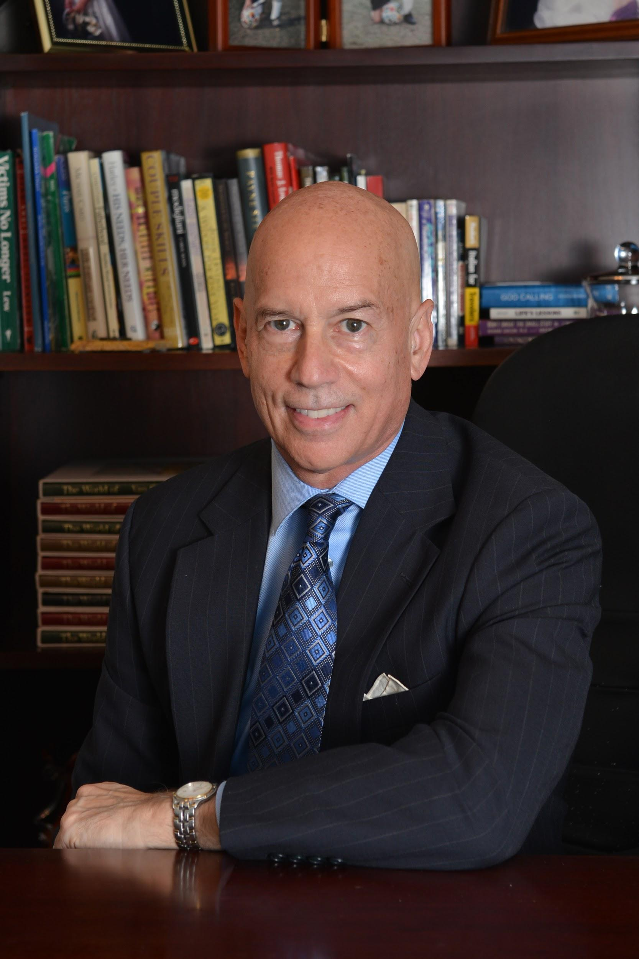
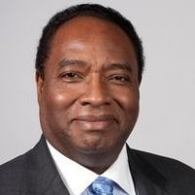
Contact Information
TOM GUZZARDO HENRY WHITLOW
Phone: 678.898.5885 404.202.6464
Email: tom@topleaderscoach.com hwhitlow@cau.edu
Website: www.topleaderscoach.com

