Slide 1



Slide 2

Cammie Scott
NAIFA President

Slide 3
Today’s Agenda
Welcome, Cammie Scott, NAIFA President
CEO Update, Kevin Mayeux, NAIFA CEO
Introduction of Speakers, Cammie Scott
Stimulus Package Overview: Diane Boyle, SVP, Government Relations
Panel Discussion: Keith Gillies, Todd Villarrubia, Mark Massey

Slide 4
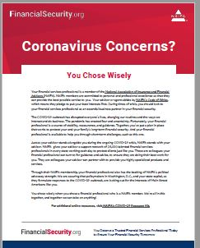
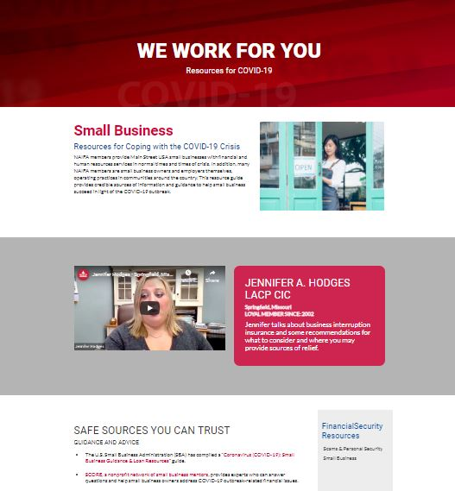
Town Halls are for You
Tools for Your Clients: New Member Website
  Downloadable Collateral to Send to Clients & Prospects
  Collaborative Library
  Get Involved with Video
Tools for Consumers:
FinancialSecurity.org

Slide 5
April Town Hall Series
April 6: Jamie Hopkins
April 9: Bill Cates
April 13: Dave Resseguie
April 16: Joe Jordan
April 20: Diedre Van Nest
April 23: Wade Pfau
April 27: David McKnight
April 30: Scott Brennan

Slide 6
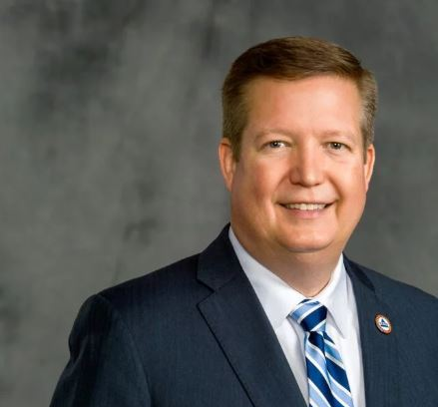
Kevin Mayeux
NAIFA CEO

Slide 7
CEO Update
Letter to All Chief State Regulatory Officials on Producer License Accommodations & to CEOs on Commissions Protecting the Producer
Creation of Trusted & Safe Resources for Consumers
Continued work on the FEMA NBEOC

Slide 8
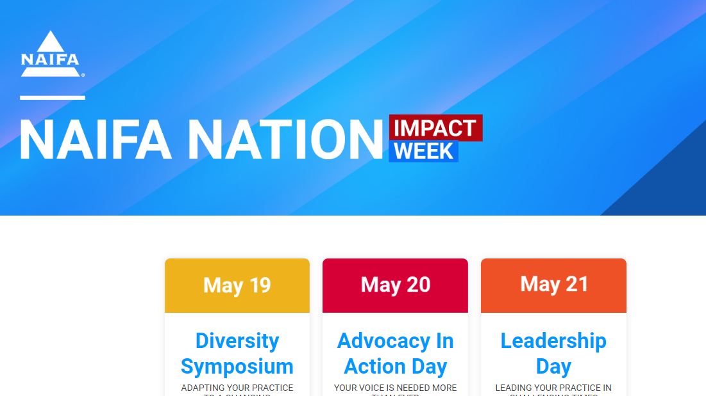

Slide 9

Cammie Scott
NAIFA President
Today’s Speakers

Slide 10




SPEAKERS
Diane Boyle
Keith M. Gillies
Todd Villarrubia
Mark Massey
SVP Government Relations, NAIFA
Managing Principal of Wealth Solutions, LLC
Board Certified Expert in Estate Planning and Administration
Vice President of SMA Services Inc

Slide 11
Understanding
The CARES Act:
How the Stimulus Package Will Impact
Consumers and Small Businesses

Slide 12
Phase
Phase
Phase
1
2
3
Initial support and vaccine development
Paid leave, unemployment and food assistance
Major economic stimulus package
H.R. 6074 — Coronavirus Preparedness and Response Supplemental Appropriations Act
$8.3 billion in COVID-19 response funding for developing a vaccine and preventing further spread of the virus
$7 billion in SBA loans
Became law on 3/6/20
H.R. 6201 — Families First Coronavirus Response Act
$100 billion in worker assistance, including emergency paid sick leave, food assistance, and unemployment payments
Became law on 3/18/20
H.R. 748 CARES Act
Major stimulus package ($2 trillion)
Loans and support to major industries, including airlines and small businesses
Direct payments to individuals and families
Became law on 3/27/20
Notes:
Sources:
Andrew Restuccia, Andrew Duehren, and Lindsay Wise, “U.S. Seeks to Send Checks to Americans as Part of Stimulus Package,” The Wall Street Journal, March 17, 2020,
https://www.wsj.com/articles/trump-administration-seeking-850-billion-stimulus-package-11584448802.
Erica Werner and Jeff Stein, “White House coronavirus plan aims to send $2,000 to many Americans, includes $300 billion for small businesses,” The Washington Post, March 18, 2020,
https://www.washingtonpost.com/business/2020/03/18/trump-coronavirus-economic-plan/.
“H.R.6074 - Coronavirus Preparedness and Response Supplemental Appropriations Act, 2020,” Congress.gov, accessed March 18, 2020,
https://www.congress.gov/bill/116th-congress/house-bill/6074.
“H.R.6201 - Families First Coronavirus Response Act,” Congress.gov, accessed March 18, 2020,
https://www.congress.gov/bill/116th-congress/house-bill/6201.

Slide 13
Phase 1 - Coronavirus Health Funding and Small Business Loans
$8.3 billion in emergency health funding
$7 billion in small business loans
Signed into law March 6, 2020
Public Law 116-123

Slide 14
SBA Economic Injury Disaster Loans
$2 million in assistance for each affected small business
Used to pay fixed debts, payroll, accounts payable and other bills that can’t be paid due to the epidemic’s economic impact
3.75% interest rate for small businesses
2.75% interest rate for nonprofits.
Every type of small business has a size standard identified by a code under the North American Industry Classification System
Apply at SBA’s Disaster Assistance website or call (800) 659-2955
SBA designation for small business insurance agencies or brokerages is $8 million in revenue
Portfolio management or investment advice are considered small businesses if they have annual sales less than $41.5 million
Applicant must affirm “Applicant is not in the business of lobbying”

Slide 15
Phase 2 - Families First Coronavirus Response Act (FFCRA)
Creates emergency paid leave programs
Applies to employers with fewer than 500 employees
Two weeks paid sick time
10 weeks leave at 2/3 salary
Signed into law March 18, 2020
Waiting for Guidance
Exception: Employers with fewer than 50 employees, may apply for an exemption to the rules if complying with them would “jeopardize the viability of the business as a going concern.”
Government pays: Payment will come by way of refundable payroll tax credits. Government-paid paid leave will also be available to self-employed individuals.

Slide 16
Emergency Paid Leave Requirements
 | What employers does this apply to? | What is the required duration of leave? | What are qualifying reasons for taking leave? | What is the required wage replacement?*
Paid sick leave Takes effect: April 2, 2020 Expires: December 31, 2020 | Private sector employers that have fewer than 500 employees Public sector employers that have one or more employees Small businesses with less than 50 employees may be exempted if leave requirements would burden the business too much | Two weeks of paid sick leave for full-time employees that meet leave eligibility requirements Part-time employee leave is based on the average hours they work | 1. Gov. mandated COVID-19 related quarantine 2. Health care provider advised quarantine 3. Experiencing symptoms or seeking diagnosis 4. Caring for quarantined individuals or children who are at home due to COVID-19 5. Experiencing a similar condition as defined by HHS | If home due to reasons 1-3: Regular rate of pay, capped at $511 daily and $5,110 in the aggregate If home due to reasons 4-5: 2/3 of regular rate of pay, capped at $200 daily and $2,000 in the aggregate
Family and medical leave Takes effect: April 2, 2020 Expires: December 31, 2020 | Private sector employers that have fewer than 500 employees Small businesses with less than 50 employees may be exempted if leave requirements would burden the business too much | Ten weeks of paid family and medical leave for full-time employees that have been with the company for at least a month Part-time employees are “eligible for leave for the number of hours that the employee is normally scheduled to work over that period” | Unable to work or telework because caring for quarantined individuals or children who are at home due to COVID-19 | At least 2/3 of regular rate of pay, capped at $200 daily and $10,000 in the aggregate
*Private sector employers that have less than 500 employees are eligible for a 100% payroll tax credit to cover required leave wages and certain medical expenses
Sources: Ways and Means Republicans, Department of Labor.
August Gebhard-Koenigstein | Slide last updated on: March 23, 2020
Notes:
"Families First Coronavirus Response Act: Employee Paid Leave Rights," Department of Labor, Accessed March 23, 2020,
https://www.dol.gov/agencies/whd/pandemic/ffcra-employee-paid-leave

Slide 17
Final Rule and Guidance
Final Rule
Final Rule: Paid Leave under the Families First Coronavirus Response Act
Fact Sheets
Employee Paid Leave Rights (PDF)
Employer Paid Leave Requirements (PDF)
Questions and Answers
Questions and Answers
COVID-19 and the Fair Labor Standards Act: Questions and Answers
COVID-19 and the Family and Medical Leave Act: Questions and Answers
Posters
Employee Rights
Notice – Frequently Asked Questions
Field Assistance Bulletin
Field Assistance Bulletin 2020-1: Temporary Non-Enforcement Period Applicable to the Families First Coronavirus Response Act (FFCRA)

Slide 18
Phase 3 - Coronavirus Aid, Relief, and Economic Security Act (CARES)
$2.2 trillion to rescue the economy
Tax rebate checks $1,200 (individuals) or $2,400 (married)
Expanded unemployment insurance
HSA, FSA, HRA enhancements
Charitable giving incentive
Retirement savings provisions
Paycheck protection program for small businesses including self-employed
Employee retention tax credit
Delays payroll tax payments for employers
Carryback of Net Operating Losses
Employer-Provided Tax-Free Student Loan Repayments
Signed into law on March 27, 2020
Full CARES Act Text

Slide 19
Tax Rebate
This comes in the form of a one-time tax rebate check of $1,200 per individual in the household and $500 per child for those with a valid SSN. There are no earned income or tax liability requirements to receive these rebate checks.
Full rebate amount for those with incomes at or below $75,000 for individuals, $112,500 for head of household, and $150,000 for married couples.
Payments are phased out above those thresholds until it is phased out completely for single taxpayers with incomes exceeding $99,000 and $198,000 for joint filers.

Slide 20
Unemployment Benefits
  Unemployment will be paid under the applicable state rules, but for four months, and with an additional federally-funded $600/week payment, when unemployment is as a result of the coronavirus crisis.
  Expands unemployment benefits to cover more workers including self-employed and independent contractors. Independent advisors, and clients like gig workers and Uber drivers, who do not usually qualify for unemployment.

Slide 21
HSA, FSA, and HRA Enhancements
Changes for users of health savings accounts (HSAs), flexible spending accounts (FSAs), and health reimbursement arrangements (HRAs):
Over-the-counter drugs and medicines not prescribed by a physician can now be reimbursed pre-tax.
Menstrual care products are now considered eligible expenses.
Health plans can now cover telehealth services pre-deductible without impacting HSA eligibility. This “safe harbor” is effective immediately but will remain so only for plan years beginning on or before December 31, 2021.
The changes to eligible expenses are retroactively effective January 1, 2020.

Slide 22
Charitable Giving Incentive
A temporary universal charitable deduction of up to $300 available for cash-only, non-itemized tax filings.
The current adjusted gross income limits will be temporarily suspended for charitable deductions for cash gifts.
Available to individuals and businesses.

Slide 23
Retirement Savings
  Suspends required minimum distributions for 2020.
  Allows plan participants to borrow all of their vested account balances, up to $100,000, and extends the time for repaying these loans.
  Waives the penalty tax on early withdrawals. Repayments of these withdrawals and loans (all of which must be coronavirus crisis-related) can be made within three years, and regular income tax on these withdrawals can be paid over a three-year period.
  Includes a rule that allows single employer defined benefit (DB) plan sponsors more time to make required contributions to their DB plans. Such payments can be deferred for a year, but interest on the required contributions for the deferred year must be paid.

Slide 24
Paycheck Protection Program
A new $350 billion loan program for small businesses, self-employed, and gig workers to help them stay afloat during the COVID-19 pandemic. If employers maintain payroll, the loans would be forgiven.
Small businesses (fewer than 500 employees), Veterans organizations, and Tribal businesses, as well as sole proprietors, self-employed and independent contractors are eligible.
Businesses in the accommodation and food service industry with more than one location - each store location could be eligible.
501(c)3 non-profits are eligible.
No other 501(c) organizations are eligible, including NAIFA chapters and chambers structured as 501(c)6s.
Physician practices are eligible, no matter how they are structured.

Slide 25
Paycheck Protection Program
The maximum size of the loan is 250% of an employer’s average monthly payroll cost during Feb. 15, 2019 to June 30, 2019, capped at $10 million.
Loan payments will be deferred for six months.
If you maintain your workforce, SBA will forgive the portion of the loan proceeds that are used to cover the first 8 weeks of payroll and certain other expenses
Eligible payroll expenses include wages and salaries, the amount of employer-paid group health insurance, retirement benefit costs, and payroll taxes payable.
Forgiven loans exclude salary amounts above $100,000 and paid leave expenses covered by the government through other coronavirus-related programs.
Loan amounts that are not forgiven will be regular loans, with terms not to exceed 10 years and at interest rates that cannot exceed four percent.
Forgiven loan amounts will not be includible in the borrower’s taxable income.
Guidance on how the program will work must be issued within 30 days of the law’s enactment
Borrowers apply for these loans through participating banks.

Slide 26
Employee Retention Credit
Employers of all sizes are eligible for a refundable 50 percent tax credit on the employer-paid portion of payroll taxes on wages up to $10,000 per employee.
Excluded from this tax credit are payroll taxes that are covered under the new paid leave and/or paycheck protection program rules.
Good option for employers not eligible for the paycheck protection program.

Slide 27
Delay in Payment of Payroll Tax
Employers would be able to delay the payment of their 2020 payroll taxes until 2021 and 2022, leading to approximately $300 billion of extra cash flow for businesses.
This provision applies to self-employed persons, too.
The provision requires that the deferred employment tax be paid over the following two years, with half to be paid by December 31, 2021 and the other half by December 31, 2022.

Slide 28
Carryback of Net Operating Losses
Five-year carryback of net operating losses that arose in 2018, 2019 or 2020.
Businesses can amend tax returns back to 2013.
Expands use of carrybacks to sole proprietors and passthrough entities.

Slide 29
Employer-Provided Tax-Free Student Loan Repayments
  Enables employers to provide a student loan repayment benefit to its employees on a tax-free basis by expanding the type of permitted expenses under an “educational assistance program” to include student loan repayments made by an employer on behalf of an employee.
  If an employer has or adopts an educational assistance program, the employer may make student loan payments on behalf of an employee up to $5,250 annually and such payments would be excluded from an employee’s taxable income.
  The $5,250 cap applies to the aggregate of the student loan payments and any other permitted qualified education expenses provided under the employer’s educational assistance program.
  The tax-free benefit for the student loan repayments applies only for payments made after March 27, 2020, and before January 1, 2021.

Slide 30
Group Health Plans
  Must cover COVID-19 diagnostic testing with no cost-sharing, prior authorization or medical management requirements.
  Must cover qualifying coronavirus preventive services at no cost sharing if in-network, within 15 business days after a recommendation is made relating to the qualifying coronavirus preventive service.

Slide 31
Small Business Resources
U.S. Department of Treasury
Top-line overview of the Paycheck Protection Program
If you’re a lender, more information can be found HERE
If you’re a borrower, more information can be found HERE
The application for borrowers can be found HERE
Small Business Administration
Paycheck Protection Program
Economic Injury Disaster Loans and Loan Advance
SBA Debt Relief
SBA Express Bridge Loans
Guidance for Businesses and Employers
SBA Products and Resources
Government Contracting
Local Assistance
Congress
FAQ from the Senate
House Small Business Loan Chart

Slide 32
Cammie Scott
NAIFA President

Slide 33
April Town Hall Series
April 6: Jamie Hopkins
April 9: Bill Cates
April 13: Dave Resseguie
April 16: Joe Jordan
April 20: Diedre Van Nest
April 23: Wade Pfau
April 27: David McKnight
April 30: Scott Brennan

