Slide 1
Town Hall
April 27, 2020

Slide 2

Today’s Host
Lawrence Holzberg
NAIFA Secretary

Slide 3
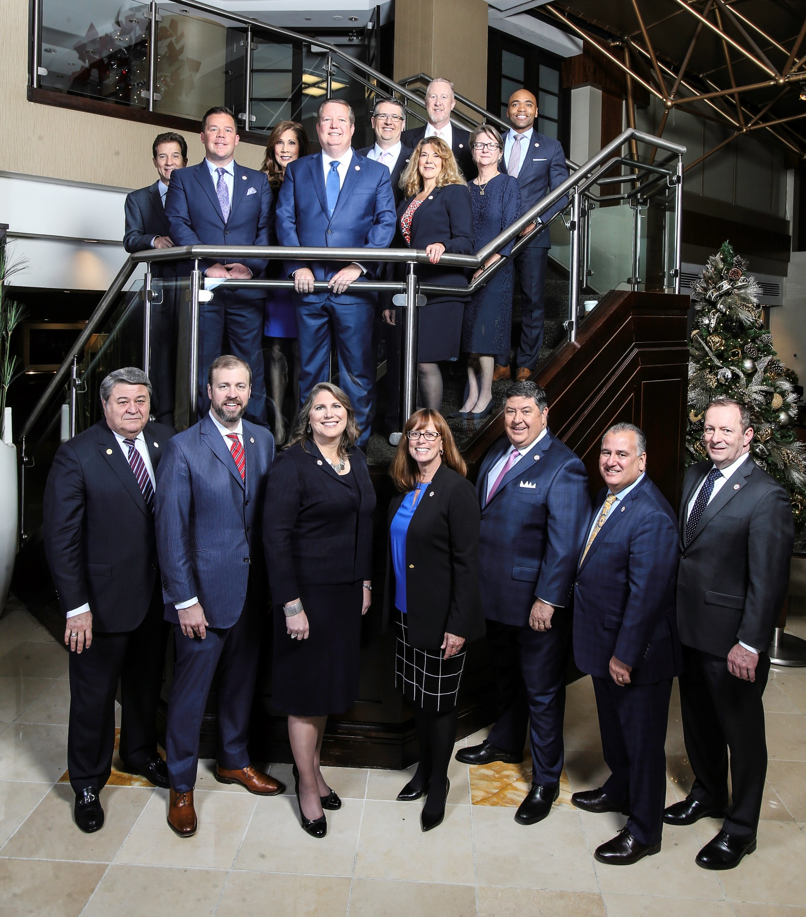
Brought to you by the NAIFA Board

Slide 4
Today’s Agenda
Welcome: Lawrence Holzberg, NAIFA Secretary
CEO Update, Kevin Mayeux
Guest Speaker: Joe Jordan

Slide 5
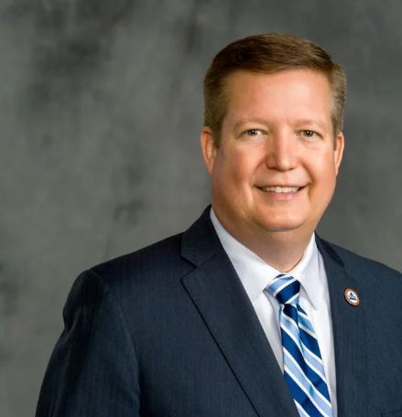
CEO Update
Kevin Mayeux, CAE
NAIFA CEO

Slide 6

NAIFA at 130
January 1, 2019 to today---
how far we have come
Thank you to our leaders, members
& partners for the support

Slide 7

130 Agencies Committed to
Increasing Financial Literacy

Slide 8

Special Webinar Invitation
How to Engage with Congress During the Coronavirus Outbreak
May 5th | 12 noon EDT

Slide 9


Slide 10
Guest Speaker Introduction

Slide 11
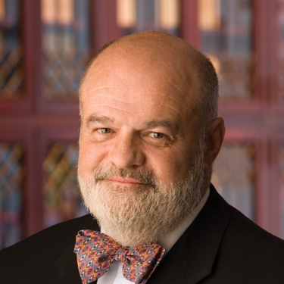
Guest Speaker:
Joe Jordan

Slide 12
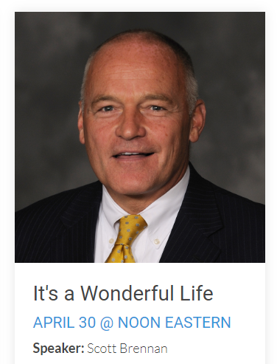
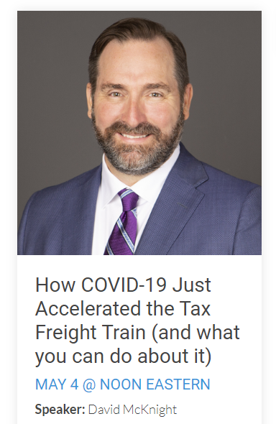
Upcoming Town Halls

